Slide 1
Intro to Computer Science & Programming for Adults
Richard White Polytechnic School
rwhite@polytechnic.org Jan-Feb, 2025

Slide 2
Welcome Back!
One more time!

Slide 3
Week 4
Creating a webpage / website
Exporting / sharing your page
HTML/CSS/Javascript
Hex colors, Fonts
Template – graphic elements - colors
BREAK
Webpage design work
Thank yous and Goodbyes

Slide 4
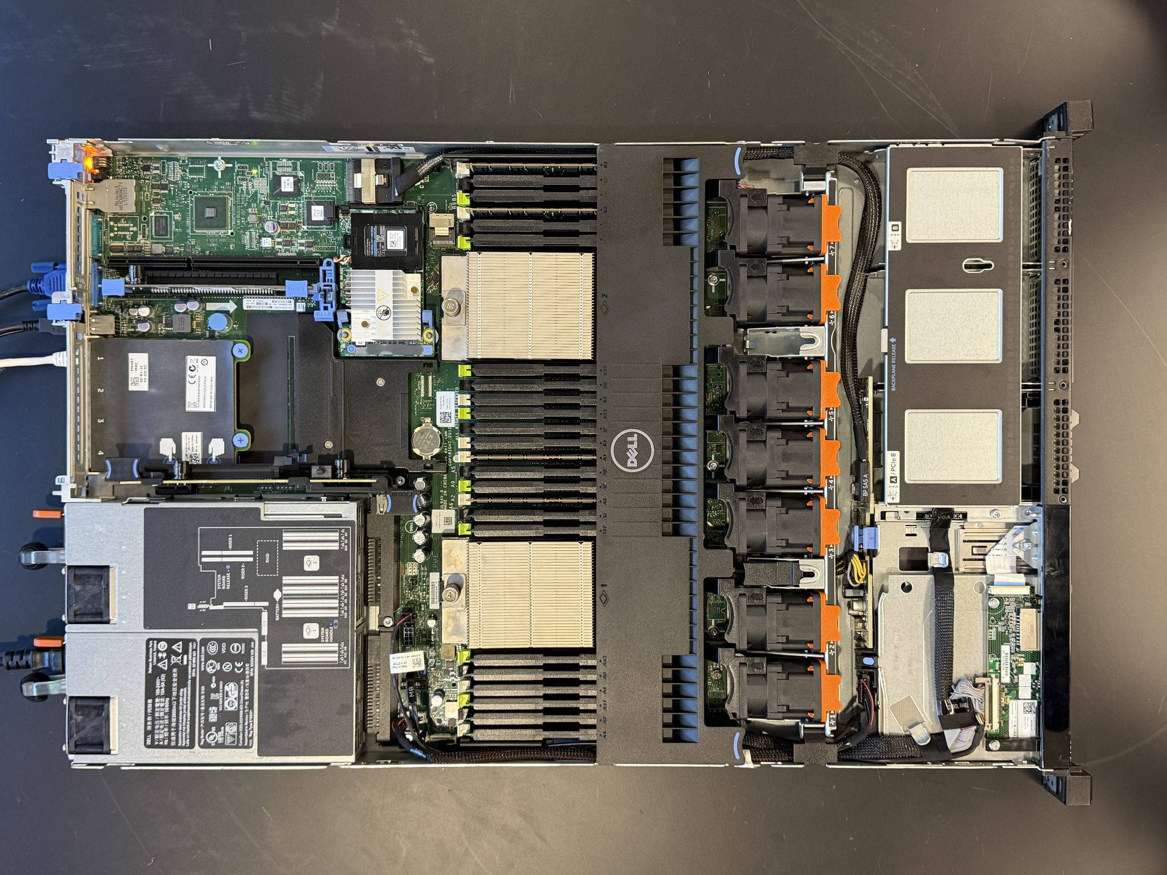
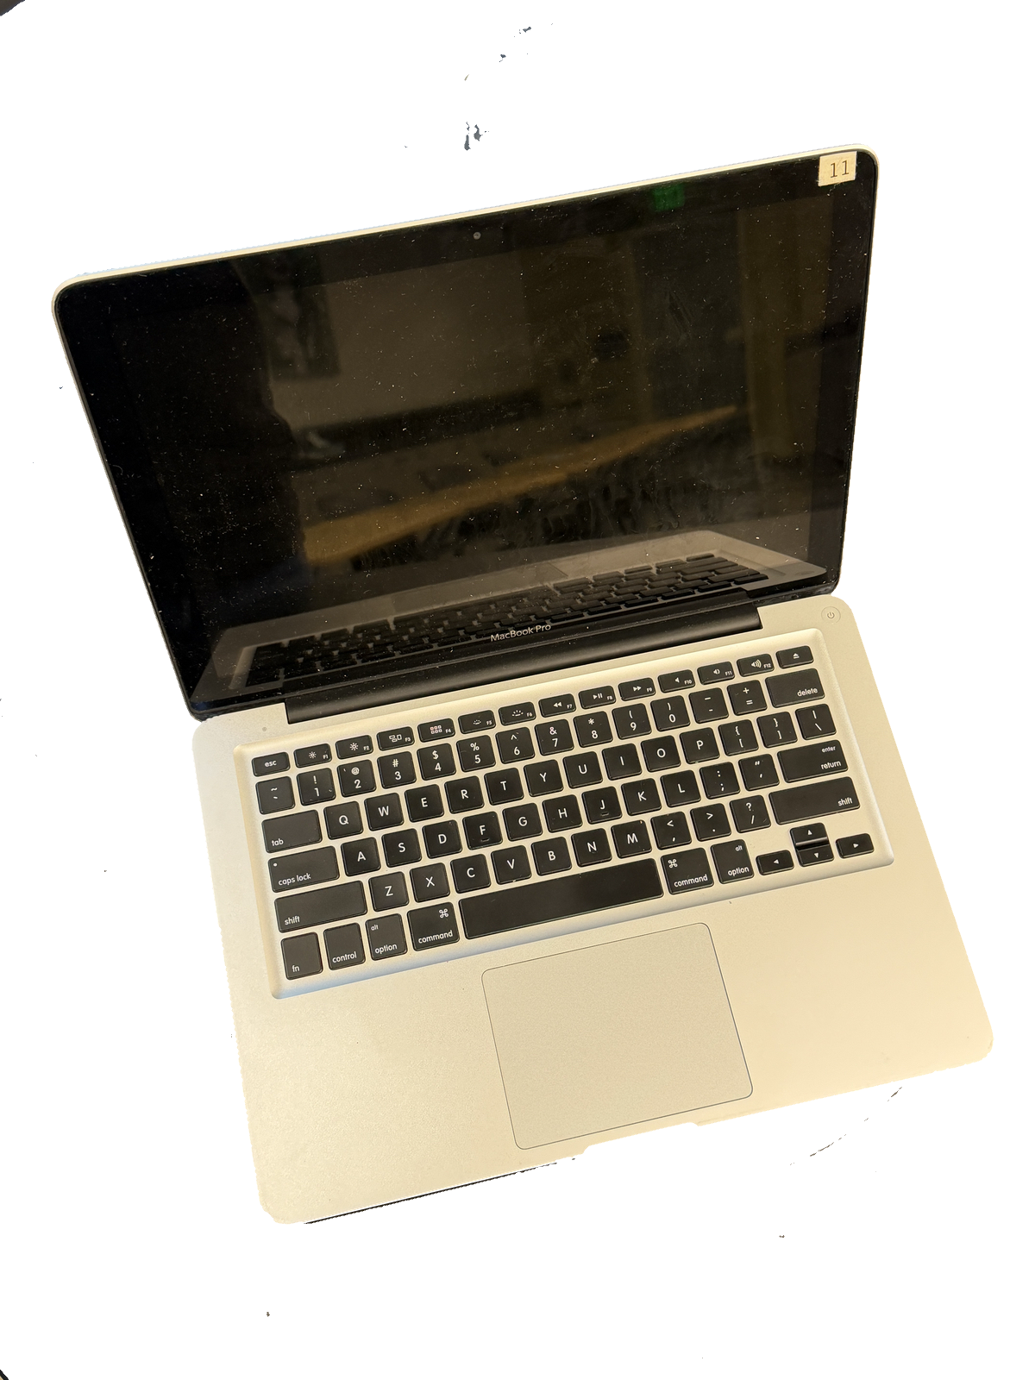
Creating a webpage
Website development and management occurs across a broad spectrum.
Server hosts files
Client/user computer, browser, internet
Developer computer, source files
Notes:
Developer computer with source files on it → Server which hosts those source files ← Client computer which requests those files for display.
Lots of places that will help you do this: Wix, Squarespace, Wordpress, etc.
Because we’ve been coding, we’re going to focus on the code that is used to create a webpage, and it’s remarkable accessible, and more forgiving (usually) than programming in Python.

Slide 5
HyperText Markup Language (HTML)
We’ll make a “good” webpage in a moment. First let’s learn a little about how HTML works.
1. Log into pickcode.com
2. Sandbox → New Project → Language: HTML... → Website → Title: lastnamefirstinitial
3. We’ll start with the index.html file that is presented to us.

Slide 6
HTML tags < > and </ >
<h1>This is a header</h1>
<h2>Smaller header</h2>
<p>Enclose a <b>paragraph</b> with these <i>tags</i>!</p>
<ol>
<li>A list with numbers</li>
<li>These are the items</li>
</ol>
<a href="https://cnn.com">CNN News</a>
<img src="header_image.jpg">
Notes:
Source code is just text, but when presented in a browser, it gets formatted (a little).

Slide 7
Cascading Style Sheets (CSS)
<head>
<style>
<!-- styling goes here -->
</style>
<body>
<!-- website goes here -->
</body>
</head>

Slide 8
Hex Color Codes
Binary is one way of coding values. Another is...
Hexadecimal, with 16 symbols, 0-9,a-f. So...
00, 01, 02, ... 09, 0a, 0b, 0c, 0d, 0e, 0f, 10, 11, 12, ... 19, 1a, 1b, 1c...
0 1 2 9 10 11 12 13 14 15 16 17 18
Colors in HTML are often indicated with a hexadecimal code
red (00-ff) green (00-ff) blue (00-ff)
#ff0099
Notes:
https://htmlcolorcodes.com

Slide 9
Fonts
Helvetica
Georgia
Gill Sans
Baskerville
Monaco
Courier
Didot
Palatino

Slide 10
Cascading Style Sheets (CSS)
<style>
body {
background: #ff0099;
color: #000000;
margin: 0; padding: 0;
font-family: Didot;
}
h1 { font-family: Georgia, serif; }
p { font-family: Gill Sans, sans-serif;
font-size: 1.2rem;
line-spacing: 1.5;
}
</style>

Slide 11
Starter files
From the webpage at crashwhite.com/cs4a/session4.html get the file html_files.zip.
Follow the instructions on our website to get those files onto your pickcode.io website.
Once you’ve got those files there, modify as you wish to create your own website.

Slide 12
Break
Back in 10 minutes?
Notes:
Restrooms across the hall, refreshments over on the side

Slide 13
Continue to develop...
Let me know when you’re ready to try viewing your files on the Internet (via your browser or phone).
I’ll copy your files from pickcode.io onto the server.
View your website at https://crashwhite.com/cs4a/valenzuelag , etc.

Slide 14
Thank you!

Slide 15
Intro to Computer Science & Programming for Adults
Richard White Polytechnic School
rwhite@polytechnic.org Jan-Feb, 2025

