Slide 1
Intro to Computer Science & Programming for Adults
Richard White Polytechnic School
rwhite@polytechnic.org Jan-Feb, 2025

Slide 2
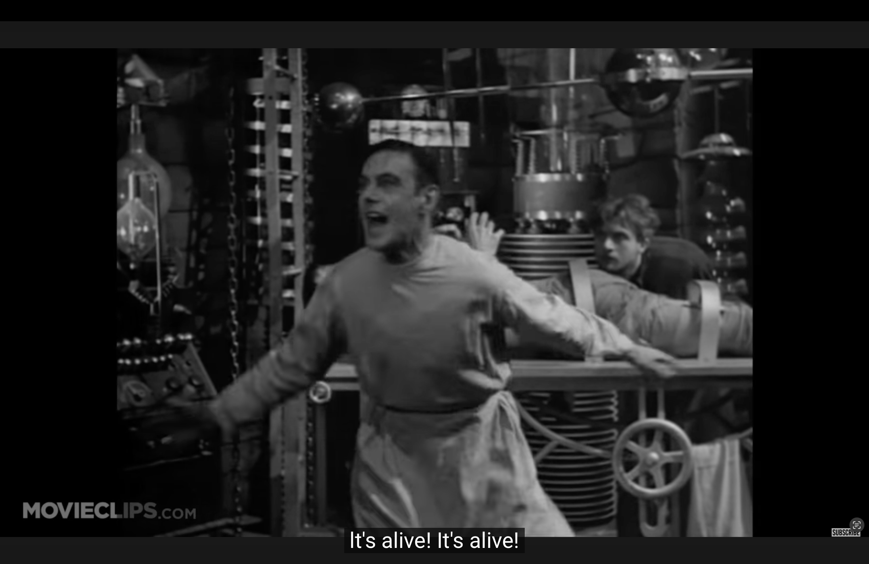
Welcome Back! All about AI

Slide 3
Week 2 – The Internet, Webpages, & Cybersecurity
How the Internet Works
How web pages work
Cybersecurity: Threat models, vectors, backups
“Have I Been Pwned?” [Activity]
Password Managers [Demo]
Break
Programming: Random numbers (pickcode.io)
Making decisions: if-else
Programming assignments: Magic 8 Ball, Guess A Number

Slide 4
Week 3 – AI, Machine Learning, & Classifiers
What even is AI anyway?
Machine Learning
Large Language Models (LLMs)
Classifiers [Activity]
Break
Programming: loops (pickcode.io)
infinite loops
Number Guessing Game

Slide 5
Week 4-TBD
Creating a personal webpage
Social media, social networks
Algorithmic Justice (FLOCK camera, Facial recognition, bias)
Gaming
Enshittification
Robots
Open conversation

Slide 6
What even is AI, anyway?
Historical Artificial Intelligence: a computer that exhibits human-level intelligence. (The Turing Test)
Artificial General Intelligence (AGI): a computer that matches or surpasses human cognitive abilities
Machine Learning: uses a trained model to identify patterns in data
Generative AI: a type of machine learning in which the patterns are used to generate new data (visual, aural, text)
Large Language Models (LLMs): generative AI models that focus on text, often supplemented with auxiliary tools

Slide 7
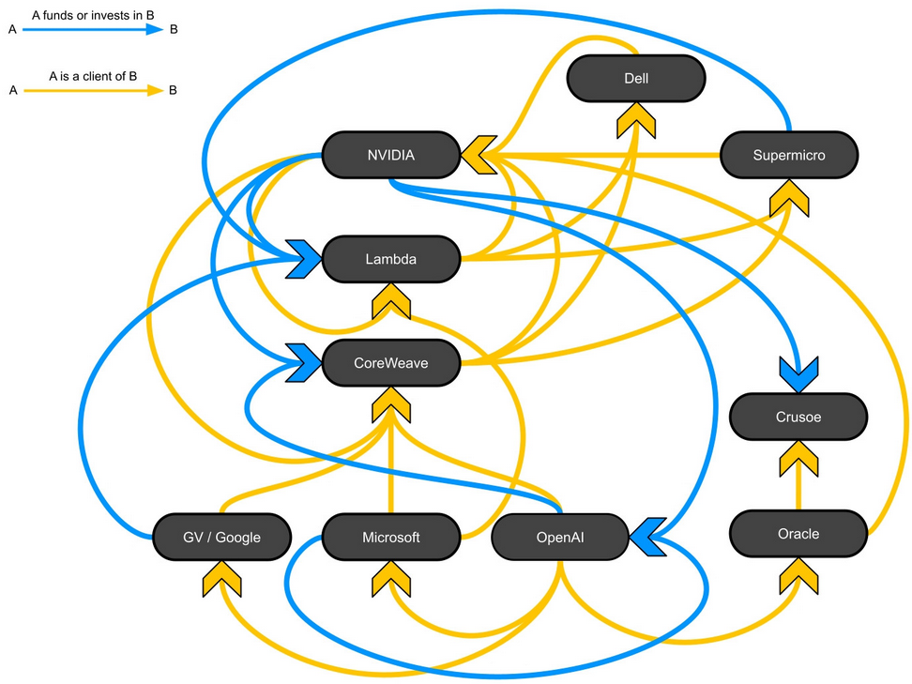
The scope of conversation
AI as a branch of computer science
AI as a tool for coders, artists, students, people
AI as hyped by tech bros
AI as an economic / financial market concern
AI as a resource issue (power, water)

Slide 8
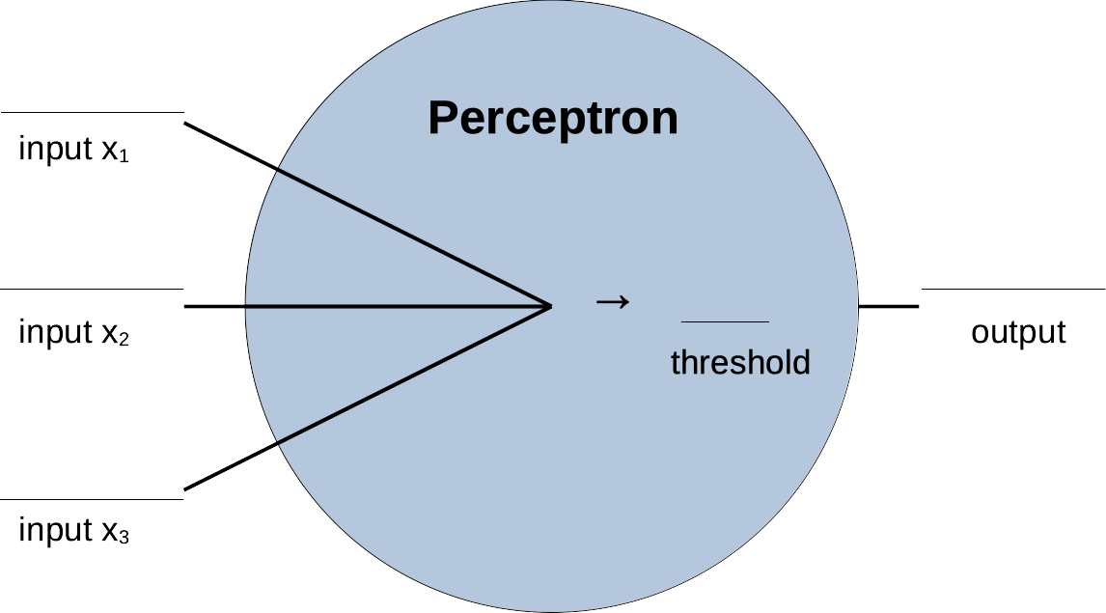
Machine Learning - Perceptron
Notes:
Concept developed in 50s and 60s. Perceptron is a simple model.

Slide 9
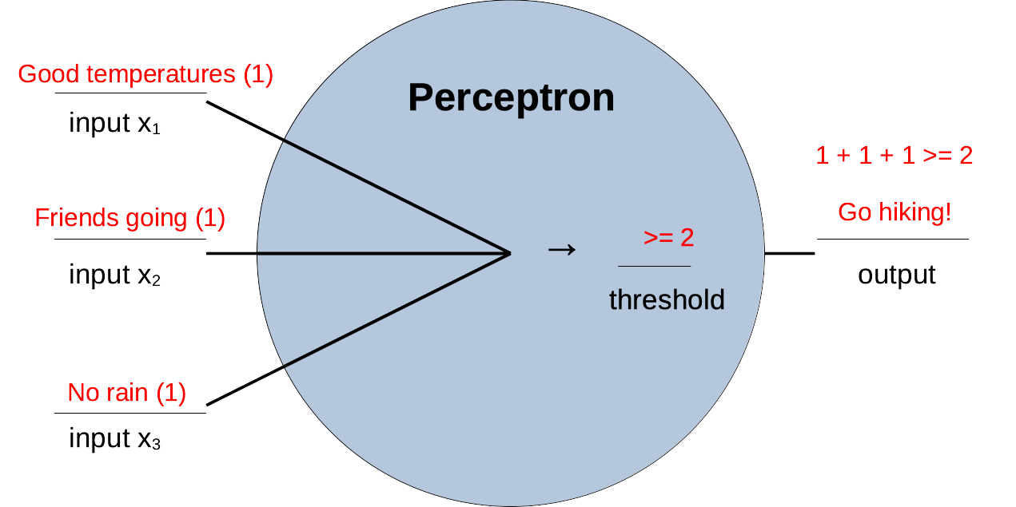
Machine Learning - Perceptron
Notes:
Binary inputs are convenient describe conditions, and the threshold is used to identify the output. This is a “binary classifier” that takes a look at the inputs and produces one of two different outputs.

Slide 10
Predicted Examples
Good temperatures | Friends going | No rain | Go Hiking
1 | 1 | 1 | 1
1 | 1 | 0 | 1
1 | 0 | 1 | 1
0 | 1 | 1 | 1
0 | 0 | 1 | 0
0 | 1 | 0 | 0
0 | 0 | 0 | 0
Notes:
Here’s a summary of that hypothetical perceptron. Based on this theoretical example, we can figure out whether or not I should go hiking. It’s easy.

Slide 11
“Actual Data” for me hiking
Good temperatures | Friends going | No rain | Go Hiking
1 | 1 | 1 | 1
1 | 1 | 0 | 0
1 | 0 | 1 | 1
0 | 1 | 1 | 1
0 | 0 | 1 | 0
0 | 1 | 0 | 1
0 | 0 | 0 | 0
Notes:
Let’s switch it up and pretend that we don’t know that much about my hiking preferences. Instead we’ve got some data that I’ve collected over the past few months. These aren’t predictions, this is actual data that differs from what I’d hypothesized before, along with some gaps in the information (the red lines). Could we find a way to predict my hiking, with some degree of accuracy?

Slide 12
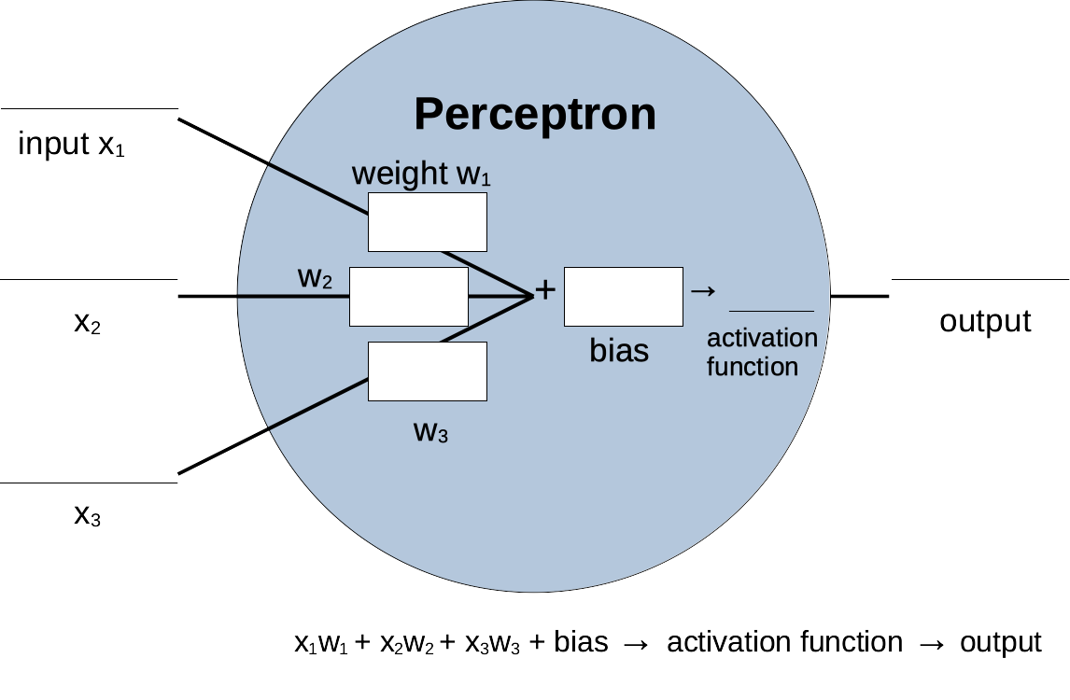
Machine Learning - Perceptron
Notes:
We’re going to modify our perceptron so that some of the inputs can be favored, or weighted, over others. We’re also going to improve out “threshold” strategy with something called “bias” and an “activation function.”

Slide 13
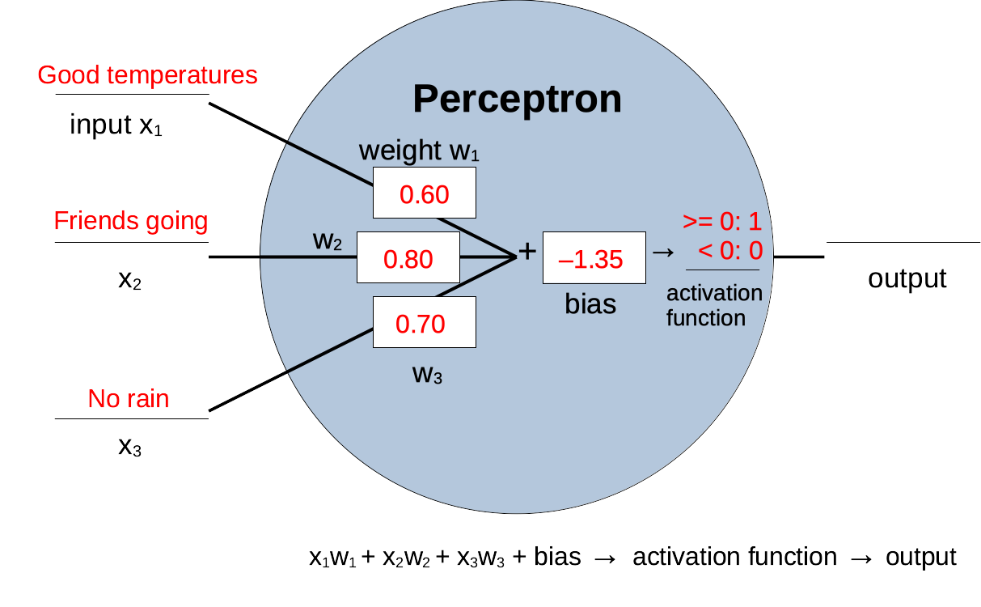
Machine Learning - Perceptron
Notes:
I’ve made up some weights here that may or may not reflect reality. And I’ve put in a bias value as well that gets added, and as a result, we’ll either go hiking (1) or not (0).
Take a look at this perceptron. If the temperature is no good (0), but friends can join (1) and there’s no rain (1), what is the numeric result? Will our perceptron recommend that we go hiking? (0.15 → 1 → hiking)
What if there are good temps (1) and no rain (1), but friends can’t go (0)? What is the numeric result?
Will the perceptron recommend that we hike? (-0.05 → 0 → no hiking)

Slide 14
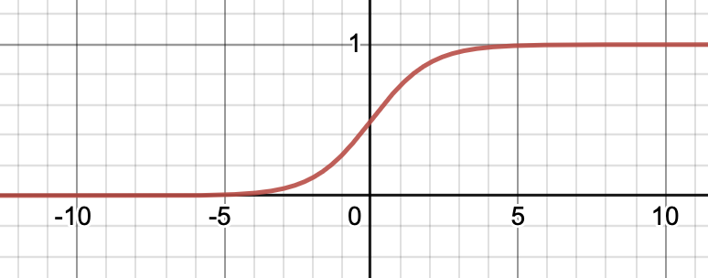
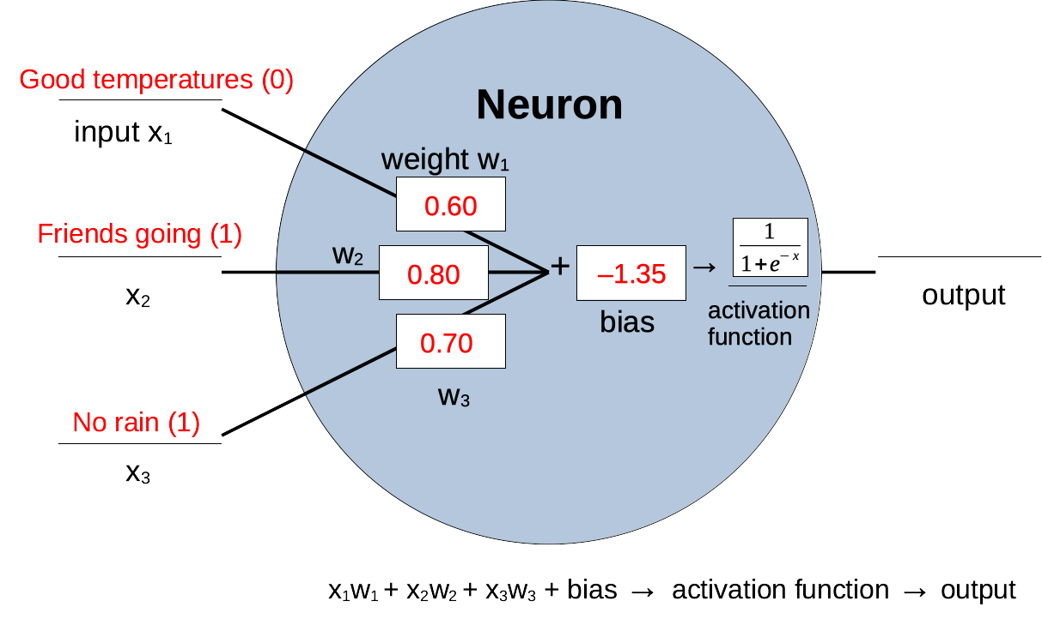
Machine Learning - Neuron
Notes:
Finally, a Neuron is similar to a Perceptron, but it’s got a more sophisticated activation function. We might be really confident that we should go hiking (1), or really confident that we shouldn’t go hiking (0), or we might get an output that’s somewhere between 0 and 1. If we get 0.89, we’re *pretty* confident we should go hiking. If we get 0.58, we’re kind of in the middle...
Here I’ve somewhat randomly chosen some values for my weights and biases. If you run these numbers, you’ll get an output of 0.5374, which isn’t terribly positive, despite the fact that two of my three inputs have been satisfied.
How could we make our Neuron better at recommending going to the beach?

Slide 15
Training a Neuron
Good temperatures | Friends going | No rain | Go Hiking
1 | 1 | 1 | 1
1 | 1 | 0 | 0
1 | 0 | 1 | 1
0 | 1 | 1 | 1
0 | 0 | 1 | 0
0 | 1 | 0 | 1
0 | 0 | 0 | 0
Can we adjust weights & bias to get these results?
Notes:
One of the things we can do to improve our Neurons weights and biases is to give it some ”training data”. These are called ”examples”, the inputs are called ”features,” and the result or output is called a ”label.” This is “labeled data” with known inputs and outputs that we can show to the neuron to say, ”These are the results you should get when the features have these values.”

Slide 16
Training Data
A model requires training data on which it can “learn,” the more data the better.
The process of training a model consists of several steps:
Obtain a large data set (possibly with known results).
Set aside some of the data for use in testing the model later.
Run the model with weights and biases that produce the some result.
Test the model with some of the reserved tasting data. Does it get the expected results?
Based on the “loss”, adjust weights and biases and test again.

Slide 17
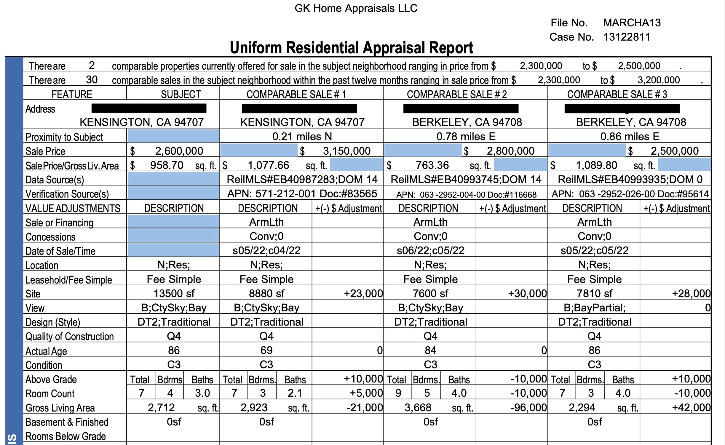
Appraiser Examples

Slide 18
Machine Learning Examples
MSSubClass | MSZoning | LotArea | LotConfig | BldgType | OverallCond | YearBuilt | YearRemodAdd | Exterior1st | BsmtFinSF2 | TotalBsmtSF | SalePrice
60 | RL | 8450 | Inside | 1Fam | 5 | 2003 | 2003 | VinylSd | 0 | 856 | 208500
20 | RL | 9600 | FR2 | 1Fam | 8 | 1976 | 1976 | MetalSd | 0 | 1262 | 181500
60 | RL | 11250 | Inside | 1Fam | 5 | 2001 | 2002 | VinylSd | 0 | 920 | 223500
70 | RL | 9550 | Corner | 1Fam | 5 | 1915 | 1970 | Wd Sdng | 0 | 756 | 140000
60 | RL | 14260 | FR2 | 1Fam | 5 | 2000 | 2000 | VinylSd | 0 | 1145 | 250000
50 | RL | 14115 | Inside | 1Fam | 5 | 1993 | 1995 | VinylSd | 0 | 796 | 143000
20 | RL | 10084 | Inside | 1Fam | 5 | 2004 | 2005 | VinylSd | 0 | 1686 | 307000
60 | RL | 10382 | Corner | 1Fam | 6 | 1973 | 1973 | HdBoard | 32 | 1107 | 200000
50 | RM | 6120 | Inside | 1Fam | 5 | 1931 | 1950 | BrkFace | 0 | 952 | 129900
190 | RL | 7420 | Corner | 2fmCon | 6 | 1939 | 1950 | MetalSd | 0 | 991 | 118000

Slide 19
Machine Learning
In supervised learning, large training sets of data are assembled: examples, made up of features, each of which have a result, or label.
This data is provided to an AI system that develops a model based on the data and an iterative process. This model is a set of numbers (weights and biases among them) that attempt to describe the relationship between the features in an example and their labels.
Notes:
The process of “developing the model” is arguably the most interesting part of this whole thing.

Slide 20
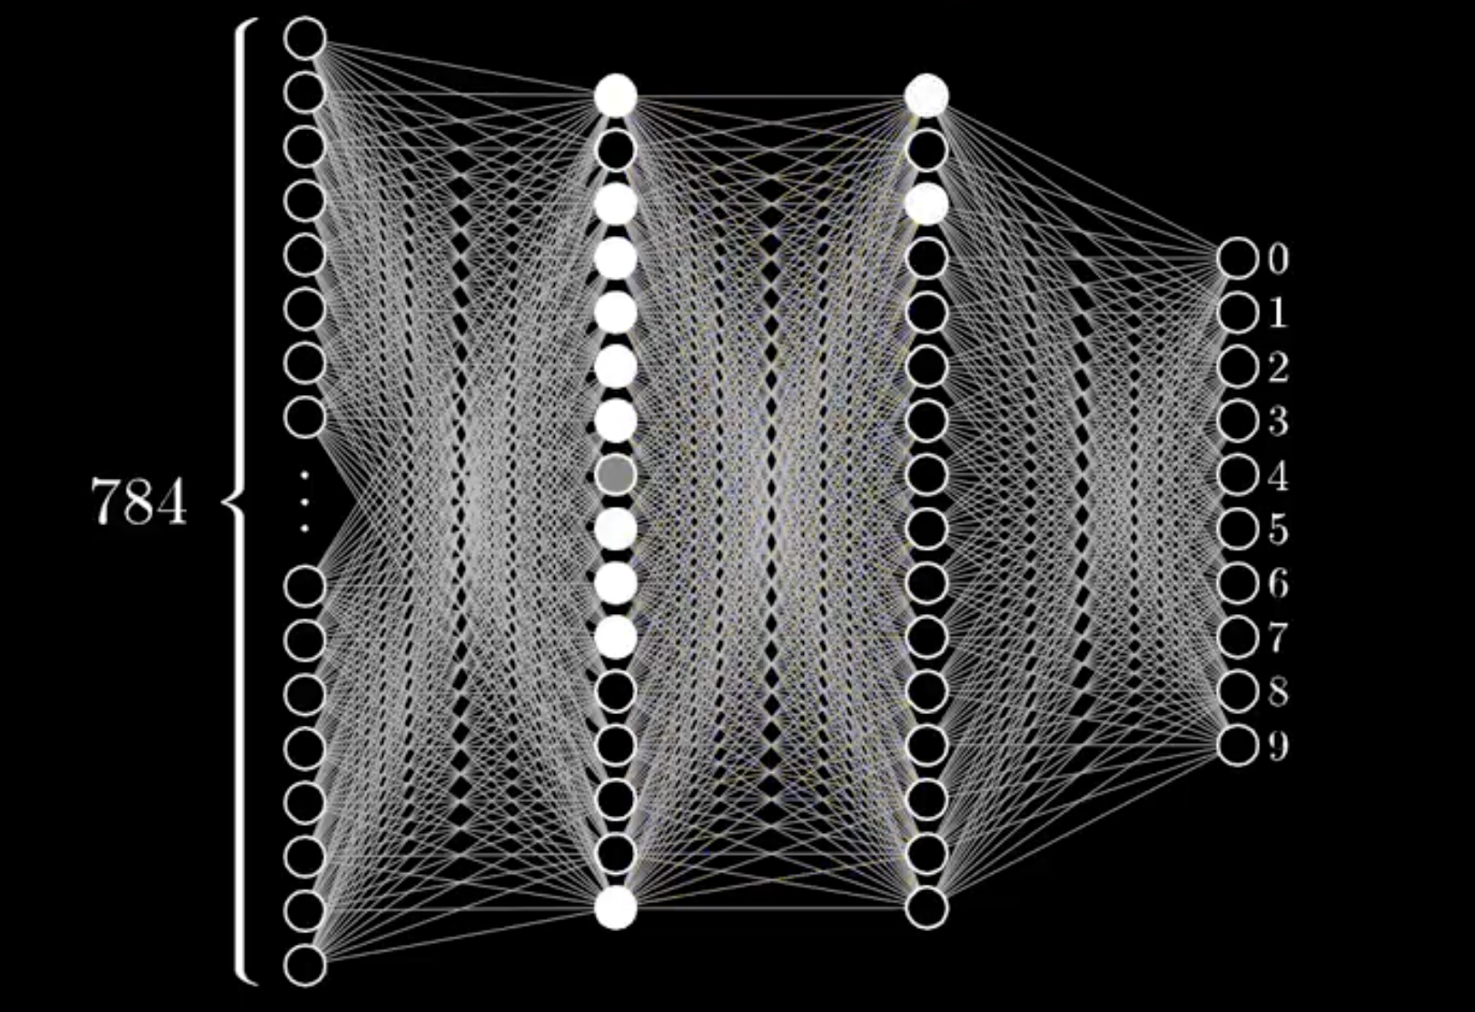
A Layer of Neurons
Our neuron example had 3 inputs, a single neuron, and a single output. Because it’s easy to create more complex structures, most Machine Learning algorithms use many more inputs, and multiple layers of neurons to better develop the weights and biases that make up a good model.
Notes:
It’s the layers of neurons that make a “neural network”, and deep learning reflects the fact that many more layers are used to help fine-tune the model.

Slide 21
Train a Classifier [Activity]
Go to https://teachablemachine.withgoogle.com and give the website access to your camera and/or microphone.
Follow the instructions and see if you can train the model to recognize the difference between two or three things.
Soda versus chips?
Red playing cards vs. black playing cards?
Cash vs. coins?
Red versus green?

Slide 22
Generative AI
“Generative AI” consists of models trained on data, with the resulting models used to generate new data.
Generated text (Large Language Models like ChatGPT, Gemini)
Generated text (coding-focused models like Claude)
Generated images
Generated audio
Generated video

Slide 23
Large Language Models (LLMs)
LLMs are based on collecting vast amounts of text (primarily from the Internet and books) and training models on that text.
The resulting models, when crafting a reply to a response, assemble words based on the probability of those words (”tokens”) occurring together ”in real life.”
The model isn’t aware of what it’s doing, and doesn’t understand what it’s doing. The words it assembles, however, are often so realistically chosen that it seems as if it know what it’s saying. It doesn’t.
Notes:
There are some additional factors that go into a Generative, Pre-Trained, Transformer, and the technology is simply astonishing.

Slide 24
LLM Python-based query [Demo]
Most LLMs provide developers with access to the models via an Application Programming Interface (API).
Each time you interact with the model, you’re charged some amount for the transaction.
Here’s what that looks like.

Slide 25
OpenAI API call - Python
from openai import OpenAI
client = OpenAI()
response = client.responses.create(
model='gpt-5-nano',
input='Write a three-sentence bedtime story with a scary, suspenseful storyline, but without any violence or blood.'
)
print(response.output_text)

Slide 26
What else do we know about LLMs?
They can be enormously useful, particularly when provided with a large amount of context.
They are probabilistic. The same prompts given to the same LLM will produce different results.
It’s not just random words. The most recent LLMs are able to build a profile of you over time, and use those in responding to your queries.
They won’t ever become AGI. There are plenty of other reasons to be worried about them, however.
They are algorithms that don’t have sentience, creativity, or emotion.
Notes:
There are some additional factors that go into a Generative, Pre-Trained, Transformer, and the technology is simply astonishing.

Slide 27
LLMs on the back end
Exploring LLMs, System prompts, Temperature

Slide 28
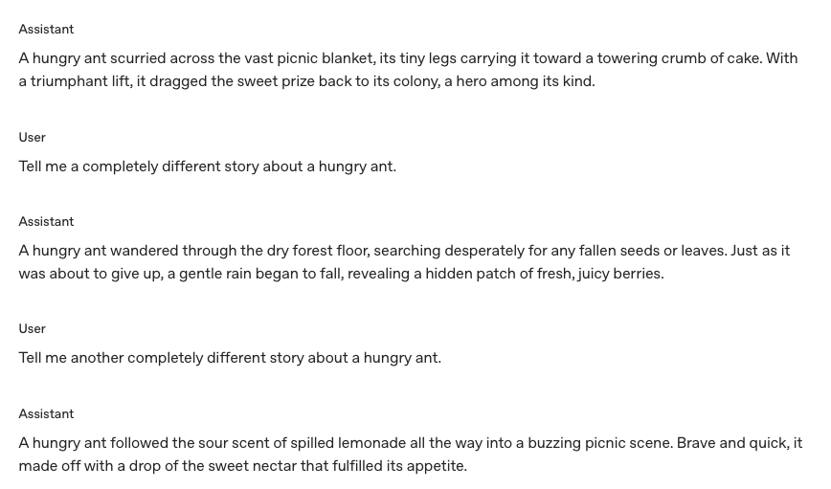
LLMs on the back end
Exploring LLMs, System prompts, Temperature

Slide 29
Break
Back in 10 minutes?
Notes:
Restrooms across the hall, refreshments over on the side

Slide 30
Programming: Loops
Computers have output and input: print(), input()
Computers can calculate w/ numbers: age = age + 1
Computers can make decisions: if-else statements
Computers can loop, repeating blocks of code: for statements

Slide 31
Programming – Random Numbers
It’s often useful to have the computer “pick a number” from a given range of numbers.
import random
def main():
# Make a random integer from 0-9
randnum = random.randrange(10)
print(randnum, "is between 0 and 9")
randnum = random.randrange(100) + 1
print(randnum, ”is between 1 and 100")
main()

Slide 32
Assignment: Guess a number
Write a program guess_a_number.py that:
makes up a random number between 1 and 10 and saves it in a variable called randnum
asks the user to guess the number (input a number and store it in a variable called guess
prints out one of three messages, depending on whether they guessed too high, guessed too low, or if they got it.

Slide 33
Programming: Loops
There are actually a few different strategies for repeating a section of code, but the simplest for us, for now, is this:
def main():
# Repeat something 20 times
for i in range(20):
print("Hi, Richard!")
# print the numbers from 1 to 100, inclusive
for x in range(1, 101):
print(x)
main()
i goes from 0 to 19
(Loop repeats 20x)
x goes from 1 to 100

Slide 34
Computers love to loop
Loops leverage the computers calculating speed to perform huge tasks. (It’s recent increases in speed that have helped fuel the calculations necessary to build AI models.) Nearly every interesting program has at least one loop in it somewhere.

Slide 35
Guessing Game
randnum = random.randrange(10) + 1
print("I'm thinking of a number...")
for g in range(1, 4):
print("Guess #", g)
guess = int(input("Guess a number between 1 & 10: "))
if guess == randnum:
print("You got it!")
break
elif guess > randnum:
print("Darn, you guessed too high.")
else:
print("Your guess was too low.")
print("The number was", randnum)

Slide 36
RandomWalker1
if direction == 0:
x = x + 1
elif direction == 1:
y = y + 1
elif direction == 2:
x = x - 1
else:
y = y - 1
turn = turn +
print(x, y, turn)
time.sleep(0.3)
if x == WIDTH // 2 and \
y == HEIGHT // 2:
break
print("Done after " , turn, "steps!")
main()
import time
import random
import os
def main():
WIDTH = 40
HEIGHT = 10
x = WIDTH // 2
y = HEIGHT // 2
turn = 0
for step in range(1000):
direction = random.randrange(4)

Slide 37
RandomWalker2
import time
import random
import os
def disp(WIDTH, HEIGHT, x, y):
os.system("clear")
for row in range(HEIGHT):
for col in range(WIDTH):
if row == y and col == x:
print("@",end='')
elif row == HEIGHT // 2 and col == WIDTH // 2:
print("+",end='')
else:
print(".",end='')
print()
return

