Slide 1
Intro to Computer Science & Programming for Adults
Richard White Polytechnic School
rwhite@polytechnic.org Jan-Feb, 2025

Slide 2
Welcome!
“I’m so glad you’re here!”

Slide 3
Week 1 – Intro to Computers & Computational Thinking
Hardware
Operating Systems
File Systems
Open House [Activity]
Break
Software, Binary Numbers, and Encapsulation [Demo]
An introduction to writing code (pickcode.io)
”I want the computer to talk to me.” print()
“I want to talk to the computer.” s = input()

Slide 4
Week 2 – The Internet, Webpages, & Cybersecurity
How the Internet Works
How web pages work
Cybersecurity: Threat models, vectors, backups
“Have I Been Pwned?” [Activity]
Password Managers [Demo]
Break
Programming: Random numbers (pickcode.io)
Making decisions: if-else
Programming assignments: Magic 8 Ball, Guess A Number

Slide 5
Week 3 – AI, Machine Learning, & Classifiers
What even is AI anyway?
Machine Learning
Large Language Models (LLMs)
Classifiers [Activity]
Break
Programming: loops (pickcode.io)
infinite loops
Number Guessing Game

Slide 6
Week 4 – ?

Slide 7
Hardware
The electronic components that make up a typical computer include:
a Central Processing Unit (CPU)
memory – Random Access (RAM, 2GigaBytes, 16GB, 64GB)
memory – secondary storage (HD or SSD, 256GB RAM? 2TB RAM?)
network – internet, wired or wireless
peripherals
output: monitor, printer, speakers
input: keyboard, mouse, microphone

Slide 8
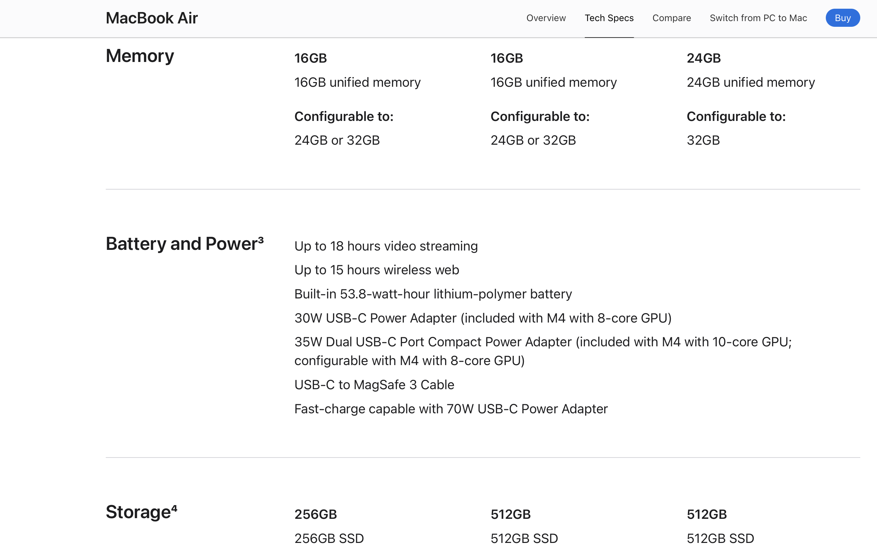
Hardware

Slide 9
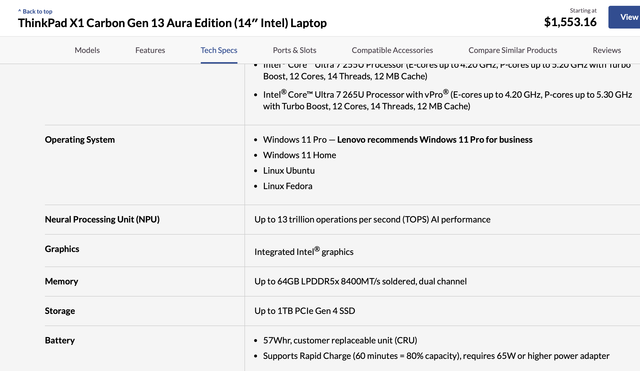
Hardware

Slide 10
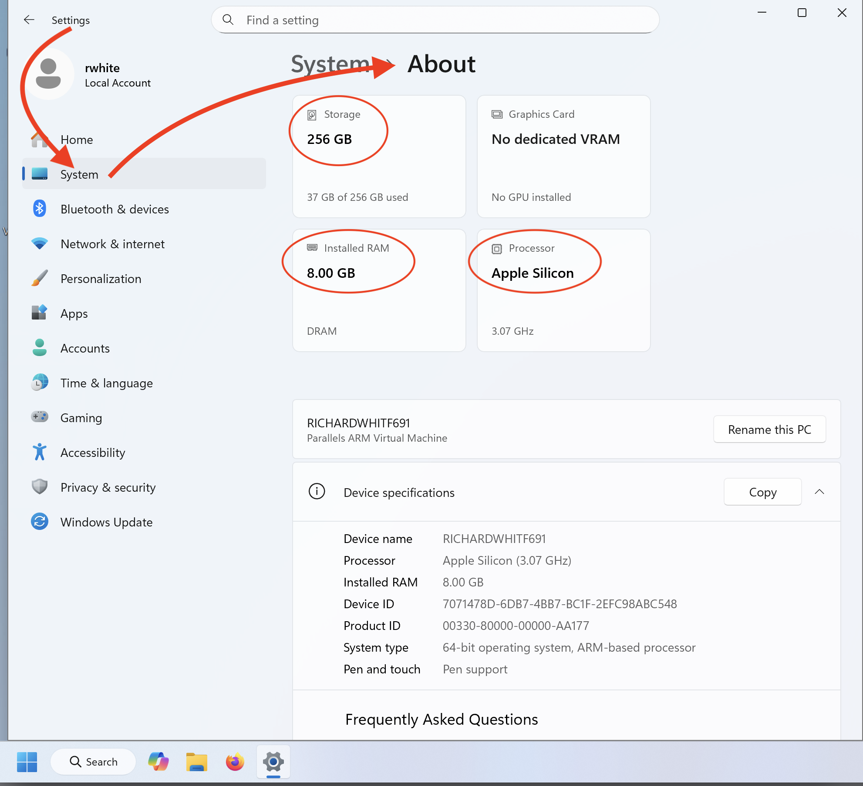
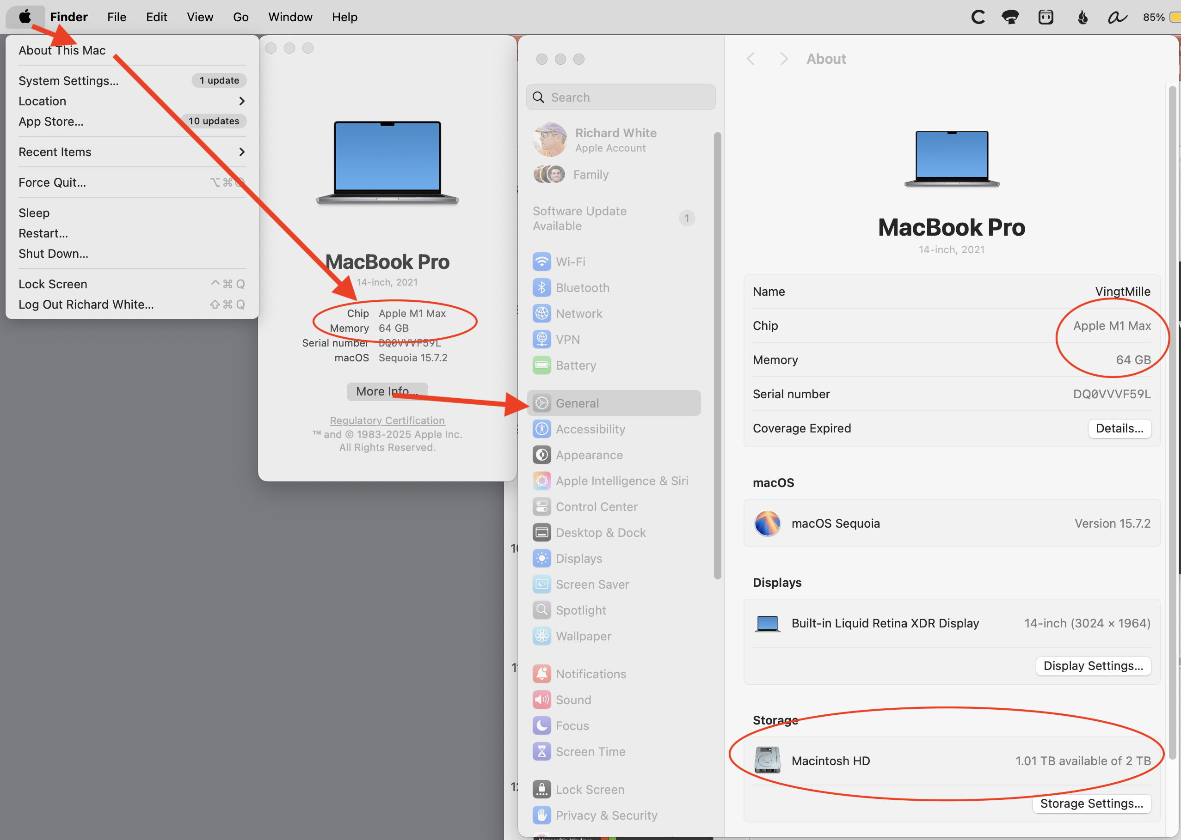
Hardware [Activity]
Identify your CPU, your RAM, and your Disk Drive for your computer.
Notes:
Discuss difficulty of identifying components in smaller computers,

Slide 11
Hardware [Activity]
Find these computers in the room:
a desktop computer
a “smart phone”
a “smart watch”
a server
Raspberry Pi
a computer running Windows
a computer running macOS
a computer running Linux
Notes:
Discuss difficulty of identifying components in smaller computers,

Slide 12


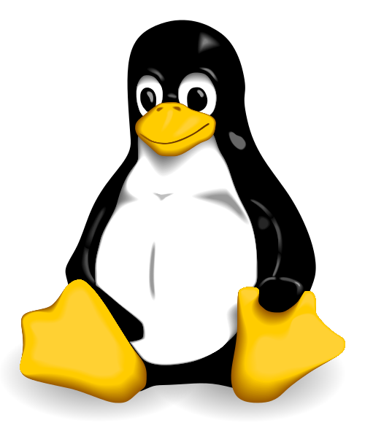
Operating Systems
The operating system is the lowest level software running on your computer. It allows other programs to run on the computer so that you can interact with it.
Apple’s macOS
Microsoft’s Windows
Open-source Linux

Slide 13
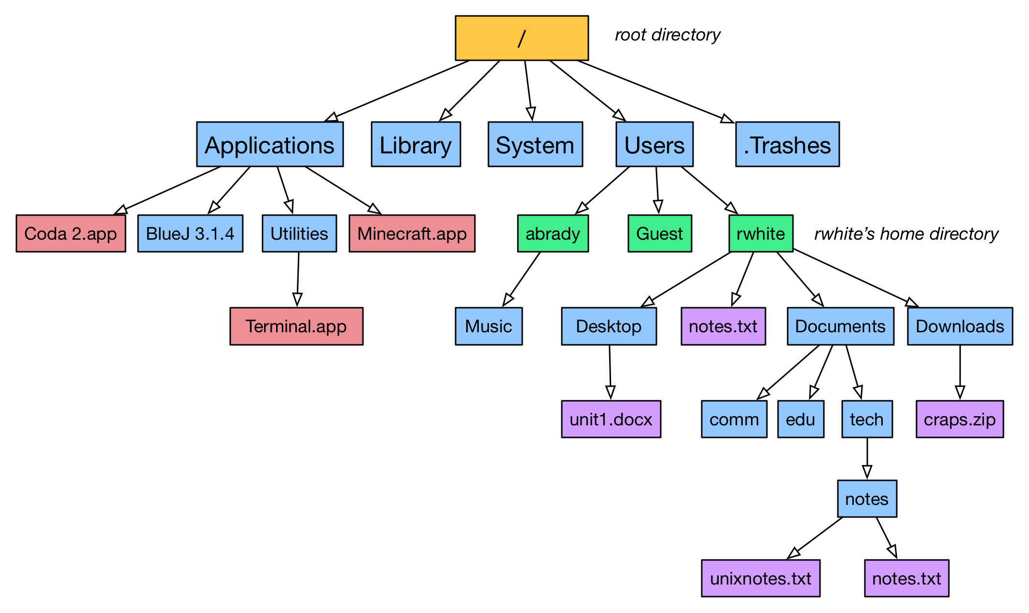
File Systems
The file system on a computer allows for the creation and editing of files and folders (“directories”). Files are typically data or programs.

Slide 14
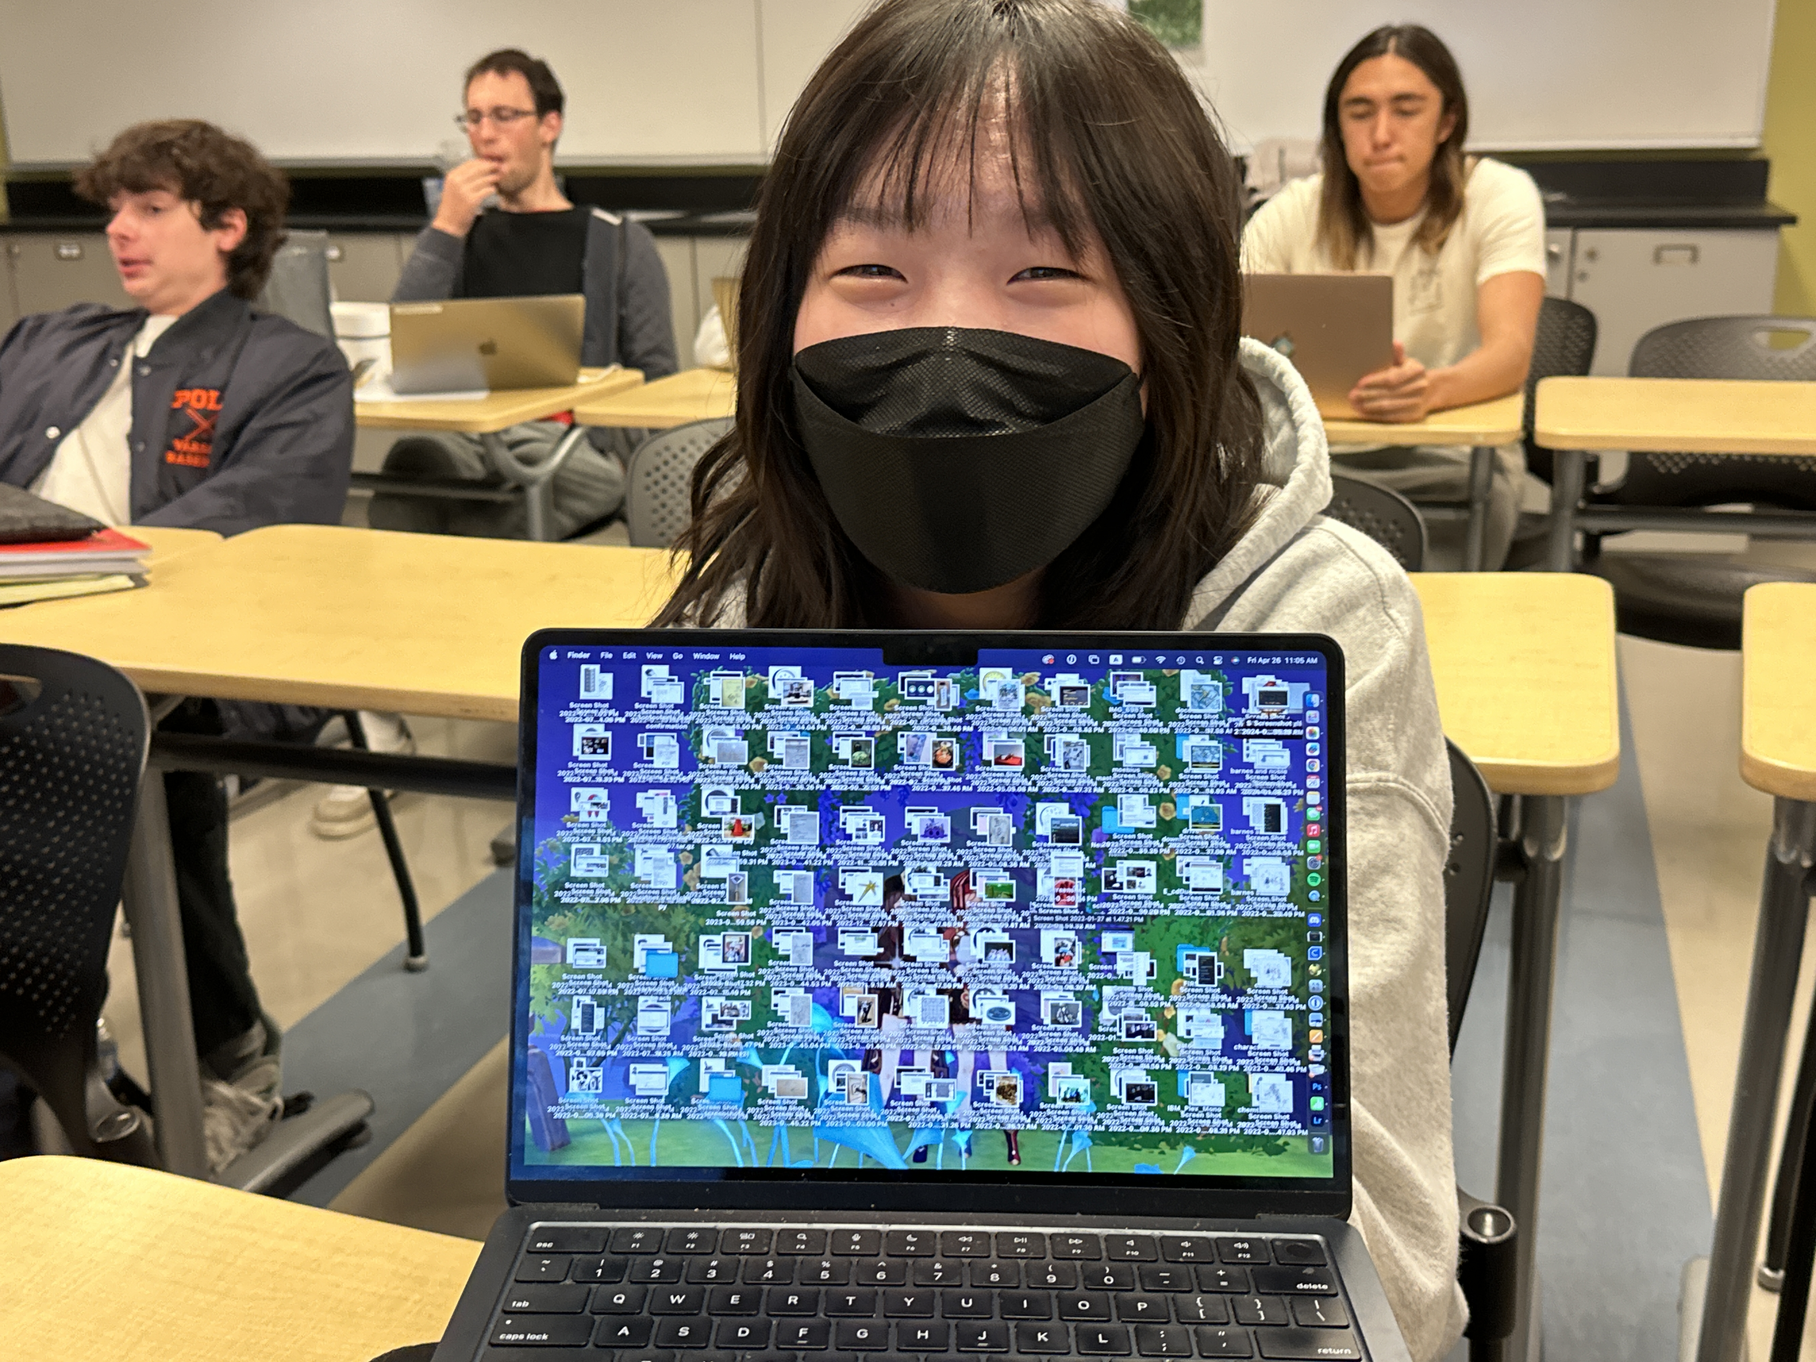
“Open House” [Activity]
Take a moment to open your laptop and hide any open windows so that you can just see your Desktop, with its background (wallpaper) and any files you might have sitting on it.
Share this view with people sitting near you.
How does their Desktop compare with yours?

Slide 15
Housekeeping [Homework]
Given how often most of us use our computers, it makes sense to do a little housekeeping every now and then.
Back up your computer?
Go through your Downloads folder?
Empty your trash
Bookmark tabs in your browser
Close programs you’re not actually using
Restart your computer

Slide 16
Binary Numbers
What does 0b1101 mean, anyway?
At the most fundamental level, all the data that a computer works with—numbers, text, and graphical images—are all represented by combinations of 1s and 0s.
Likewise, the instructions that manipulate this data—the software—are all represented by 1s and 0s.
Notes:
You may have heard that computers all run in binary, “it’s all ones and zeros.” For digital, binary computers that’s true.

Slide 17
Binary Numbers
What does 0b1101 mean, anyway?
At the most fundamental level, all the data that a computer works with—numbers, text, and graphical images—are all represented by combinations of 1s and 0s.
Likewise, the instructions that manipulate this data—the software—are all represented by 1s and 0s.
Notes:
You may have heard that computers all run in binary, “it’s all ones and zeros.” For digital, binary computers that’s true.

Slide 18
What does 0b1101 mean, anyway?
1101 = 4 binary digits = 4 bits
Decimal system
1000s 100s 10s 1s
10³ 10² 10¹ 10⁰
1 1 0 1 = 1101 = “One thousand, one hundred and one”
Binary System
8s 4s 2s 1s
2³ 2² 2¹ 2⁰
1 1 0 1 = 8 + 4 + 1 = 13 = “Thirteen”

Slide 19
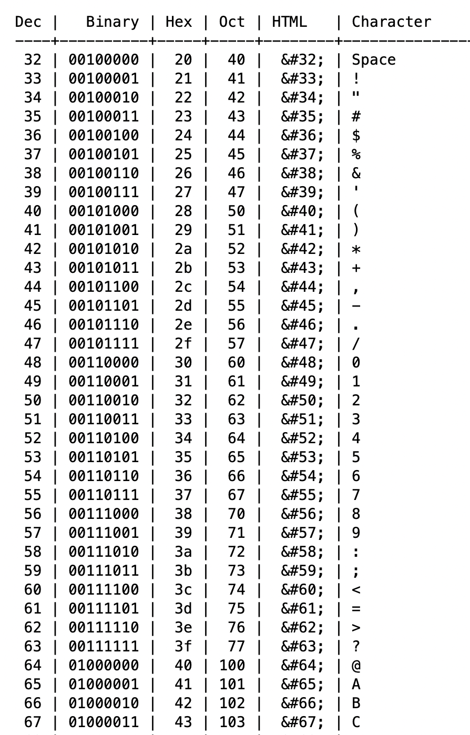
How is text represented?
American Standard Code for Information Interchange (ASCII)
UTF-8 UTF-16 UTF-32

Slide 20
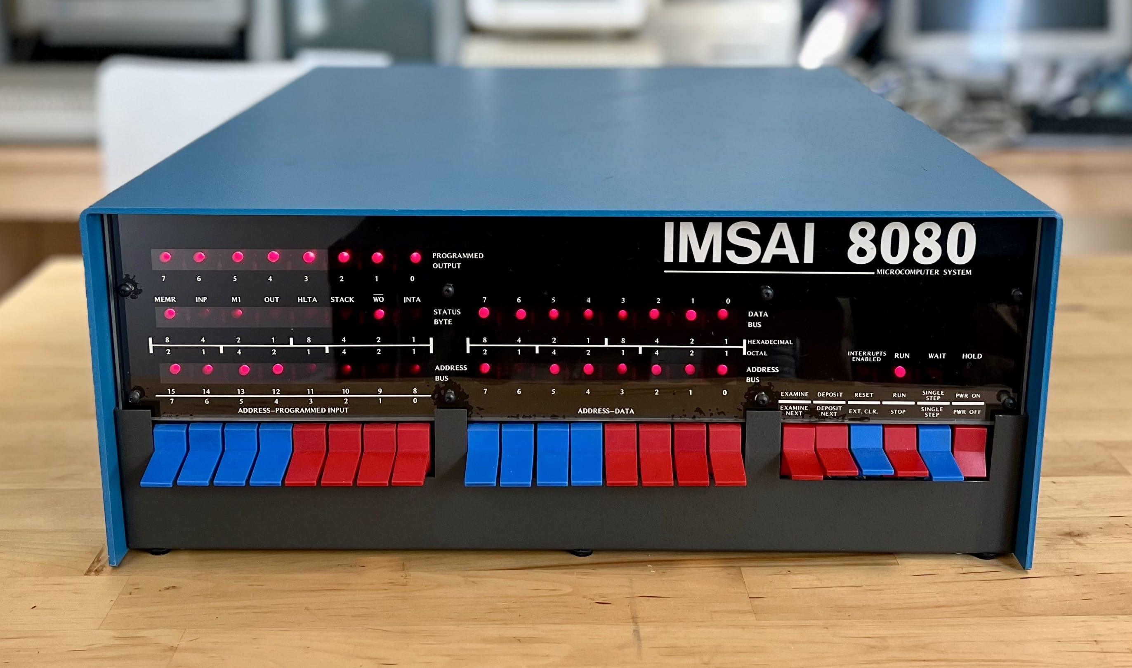
Binary Programming
https://youtu.be/wdP8WB8Dwbg?si=UnepyAdRDp73EgJw
Notes:
IMSAI 8080 came out in 1975. Switches allowed for input to the processor, and LED lights were the output.
Programming up to 4:35
Running the program (identifying prime numbers) starts at 4:35.

Slide 21
Encapsulation [Demo]
Nobody wants to talk to a computer by flipping switches. Encapsulation is the process of hiding hard-to-do things, like programming in binary.
Machine language (0s and 1s)
Assembly (Human-readable machine language)
C (high-level language that is compiled into machine language)
Python (higher-level language, written in C)
Notes:
Assembly is human-readable form of machine language
Run through Demo

Slide 22
Break
Restrooms down the hall.
Refreshments in here.
Back in 10 minutes?
Notes:
Restrooms across the hall, refreshments over on the side

Slide 23
In Introduction to writing code
What does coding look like?
Notes:
In the movies, there are lots of examples of people writing code...

Slide 24
Writing, running, debugging
The process of developing typically involves installing a bunch of software tools onto your computer, and working in a Terminal or an Integrated Development Environment. As an easy, simpler alternative, we’ll be using a browser-based tool available at https://pickcode.io
Open up a browser (Firefox, Safari, Chrome), go to that address, and create a free account for yourself.
Notes:
If we had more time or were taking this a little more seriously, we’d make some effort to get those tools installed.

Slide 25
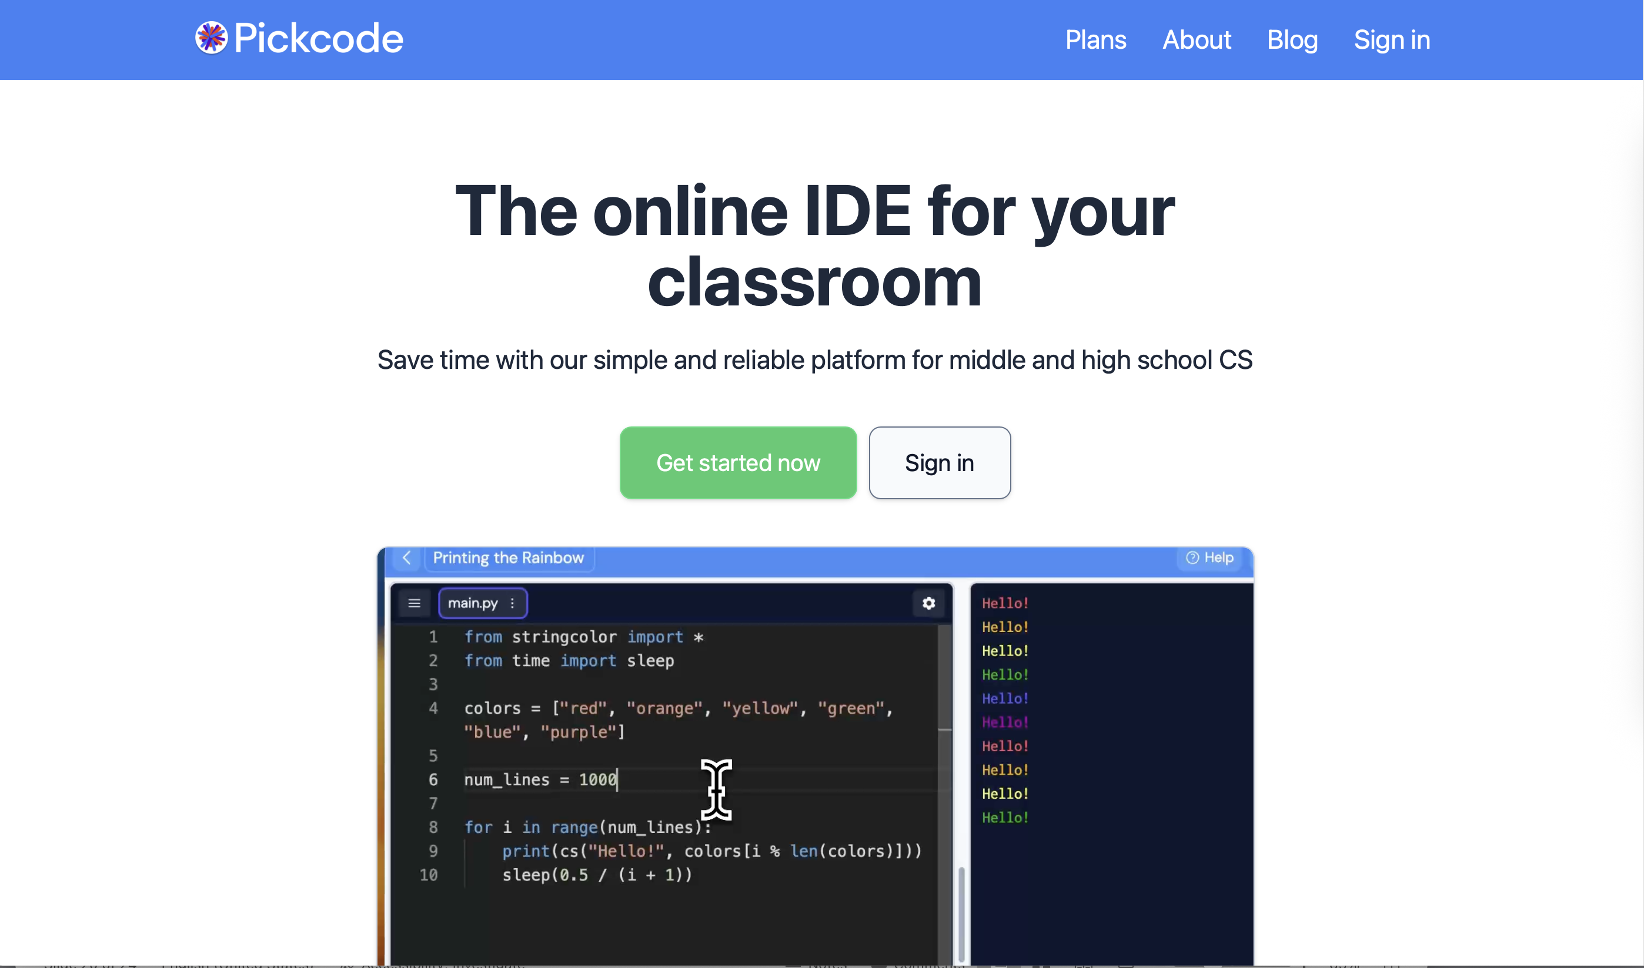
pickcode.io
Notes:
I’ve met with the lead developer of this site.

Slide 26
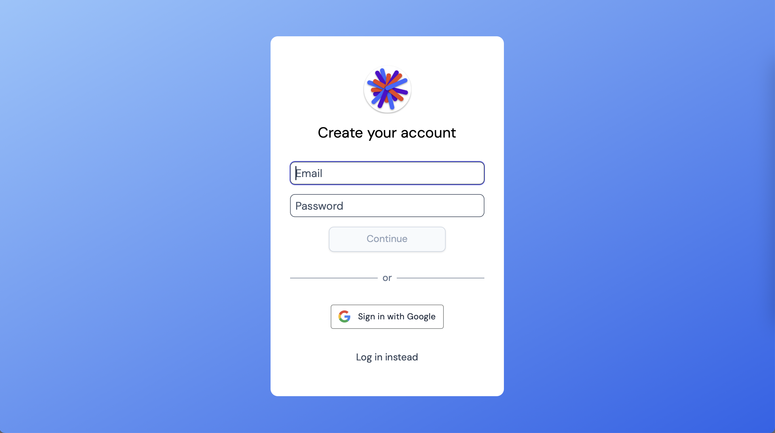
pickcode.io
Notes:
It will ask for whether you are a teacher or a student (because this is an education focused site). Choose “student”, unless you want to be contacted by the developers about using this tool in your classroom.
It will then ask for your age. I presume this is for complying with minimum-age documentation, although it could be data collection for the purposes of the site as well. Put whatever you want.
Then you’ll be able to create a free account. If you have a Google account and want to authenticate using your Google ID, that’s fine. You can also just use your own email and password.

Slide 27
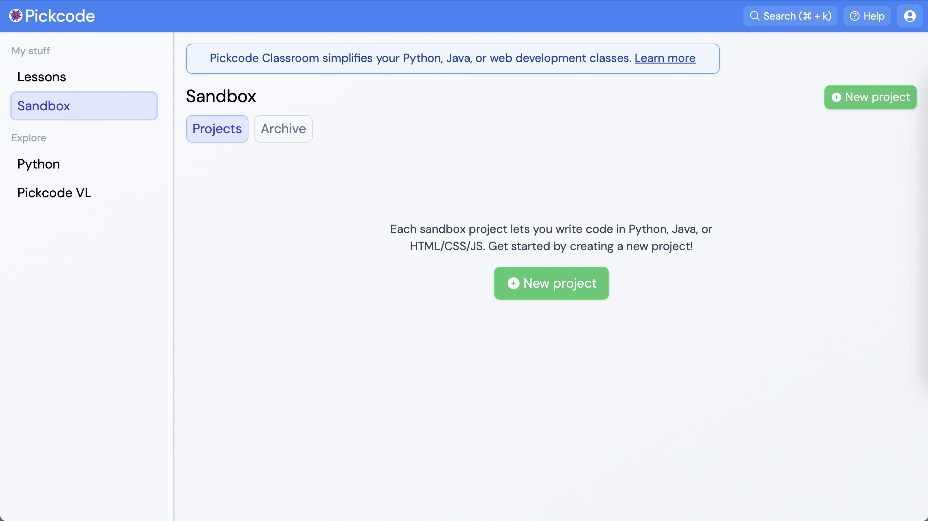
pickcode.io
Notes:
When you get to this screen, select “Sandbox” (for playing, get it?) and click on the green “New project” button...

Slide 28
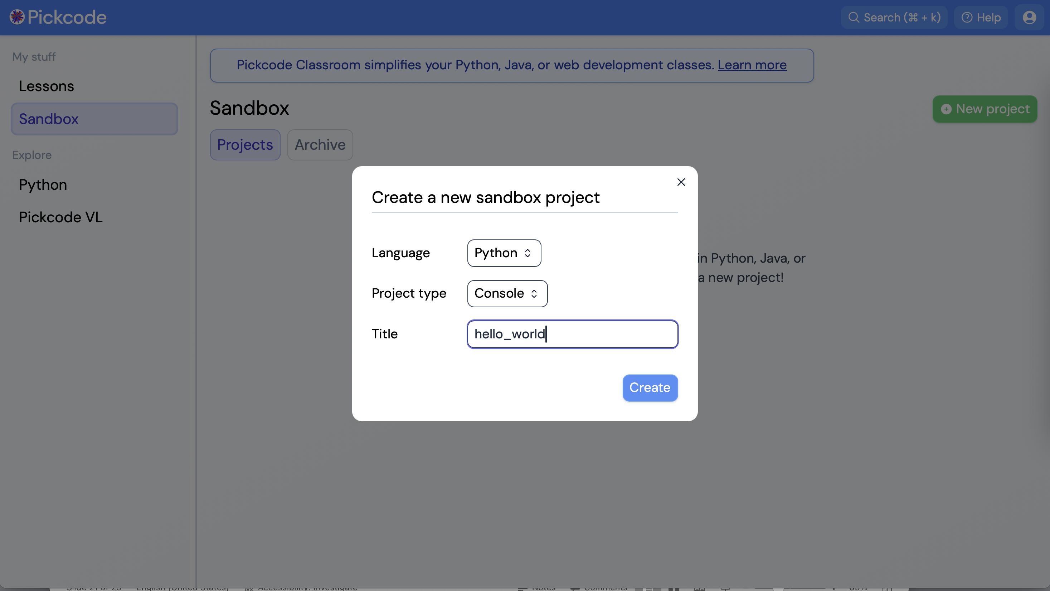
pickcode.io
Notes:
You’ll be asked what language you want to use for the project, that type it should be (choose “Console”), and what you want to call the project. We’re going to call it “hello_world” (with an underscore).

Slide 29
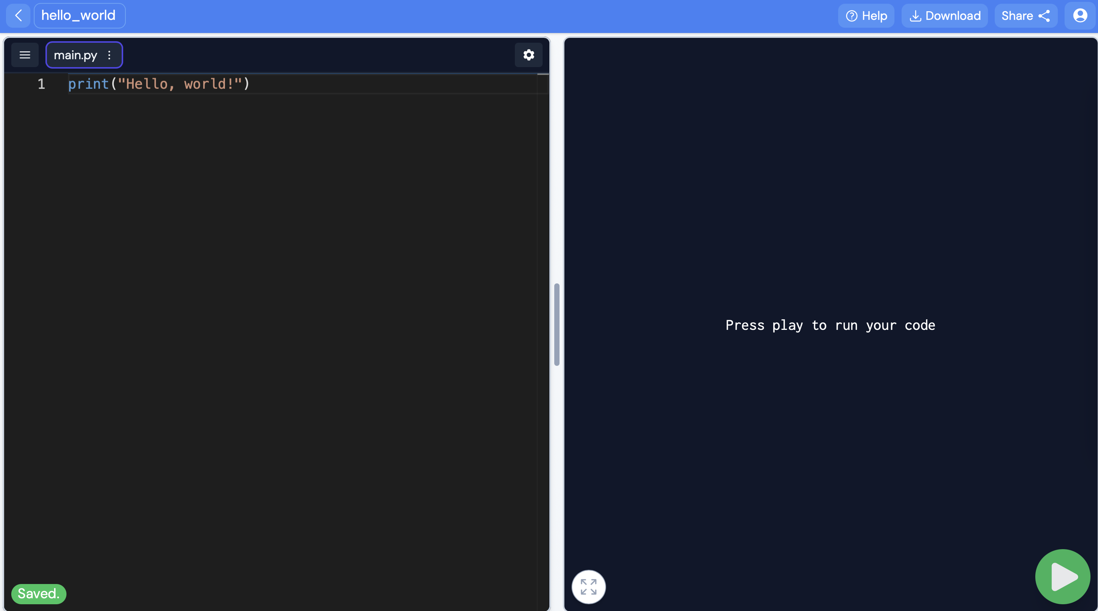
pickcode.io
Notes:
And *now* we’re starting to look a little like a hacker! We’ve got dark screens with mysterious colored text on them. We’re ready to launch the next great tech startup, or write the next data analysis tool for performing government oversight, or write the next Wordle.

Slide 30
Python3 – print() for output
Code – hello_world.py
# This is a Python program
def main():
print("Hello, world!")
print("Hello", "world!")
print(3 + 6)
print("3" + "6")
print("3 + 6")
main() # Call the main function
Notes:
Pound sign, number sign, “hash” indicates a comment—all text after that is ignored by computer
“def main():” defines a main function in our program, but doesn’t actually execute it yet. It won’t do that until we ”call” it later on.
Python is very particular about indenting. Indenting has to be just right. Using the tab key to indent a “block” of code in a function will insert four spaces, which is what Python typically uses.

Slide 31
Python3 – variables for data
Memory
Code – hello_world_personal.py
"Richard"
65
def main():
name = "Richard"
age = 65
print("Hello," , name , "!")
age = age + 1
print("Next year you will be", age, "years old.")
main() # Call the main function
name
age
Notes:
Data is stored in the computer’s memory, and can be referred to by “variables.”
Here, `name` is a variable name that we made up. You can call it `n` or anything else you want, but `name` is a good choice because it makes sense and isn’t too complicated. It’s storing a ”string” value, a “string of characters” that can be anything between single or double quotes.
We also have a variable `age` used to store a number. The number *doesn’t* have quotes around it, which is how Python knows it’s a number 65 and not the characters 6 and 5.
We can also change the value that a variable references. In the line `age = age + 1`, we’re evaluating the expression on the right and setting `age` to point to that new number. The old value is no longer there.

Slide 32
Python3 – input() for input
Code – name_and_age.py
def main():
print("Enter your name: ")
name = input() # gets a 'string'
age = int(input("Enter your age: ")) # gets number
print("Hello," , name , "!")
age = age + 1
print("Next year you will be", age, "years old. ")
main() # Call the main function
Notes:
The input statement allows us to have the user enter information into a program.
By default, values that are entered come in as `strings`. If they’re meant to be used as numbers, we have to convert them by using the int() or float() methods.

Slide 33
Assignment: mad_libs.py
Write a program that has the user enter a series of values—a noun, a color, a number, an adverb, a girl’s name, a fantastical creature, etc.—and store those values in variables. Then print out a story that uses those values.
# Sample code
animal = input("Enter the name of an animal:")
large_number = float(input("Enter a very large #:"))
nerd_name = input("Enter a nerdy name:")
print("Once upon a time, there was a herd of")
print(large_number, animal, "and the smartest one")
print("was a(n)", animal, "called",nerd_name)

Slide 34
Homework (optional)
Reading: https://www.bloomberg.com/graphics/2015-paul-ford-what-is-code - Intro and sections 1.1-2.3.

